Slide 1

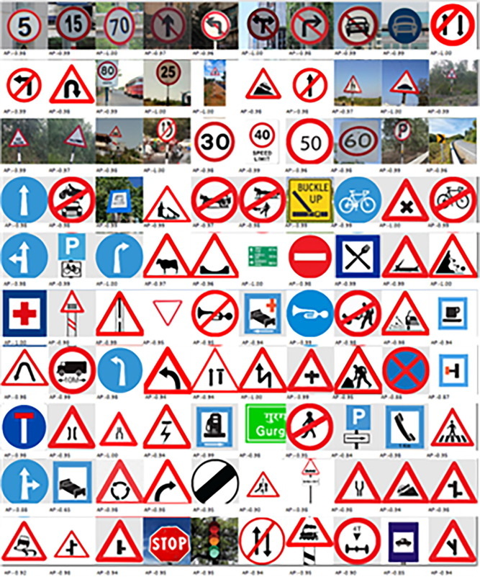
TRAFFIC SIGN DETEECTION
G.SATHYASRI
613521104041
NM ID:95882E8300765C297D24C0172B8D5373

Slide 2
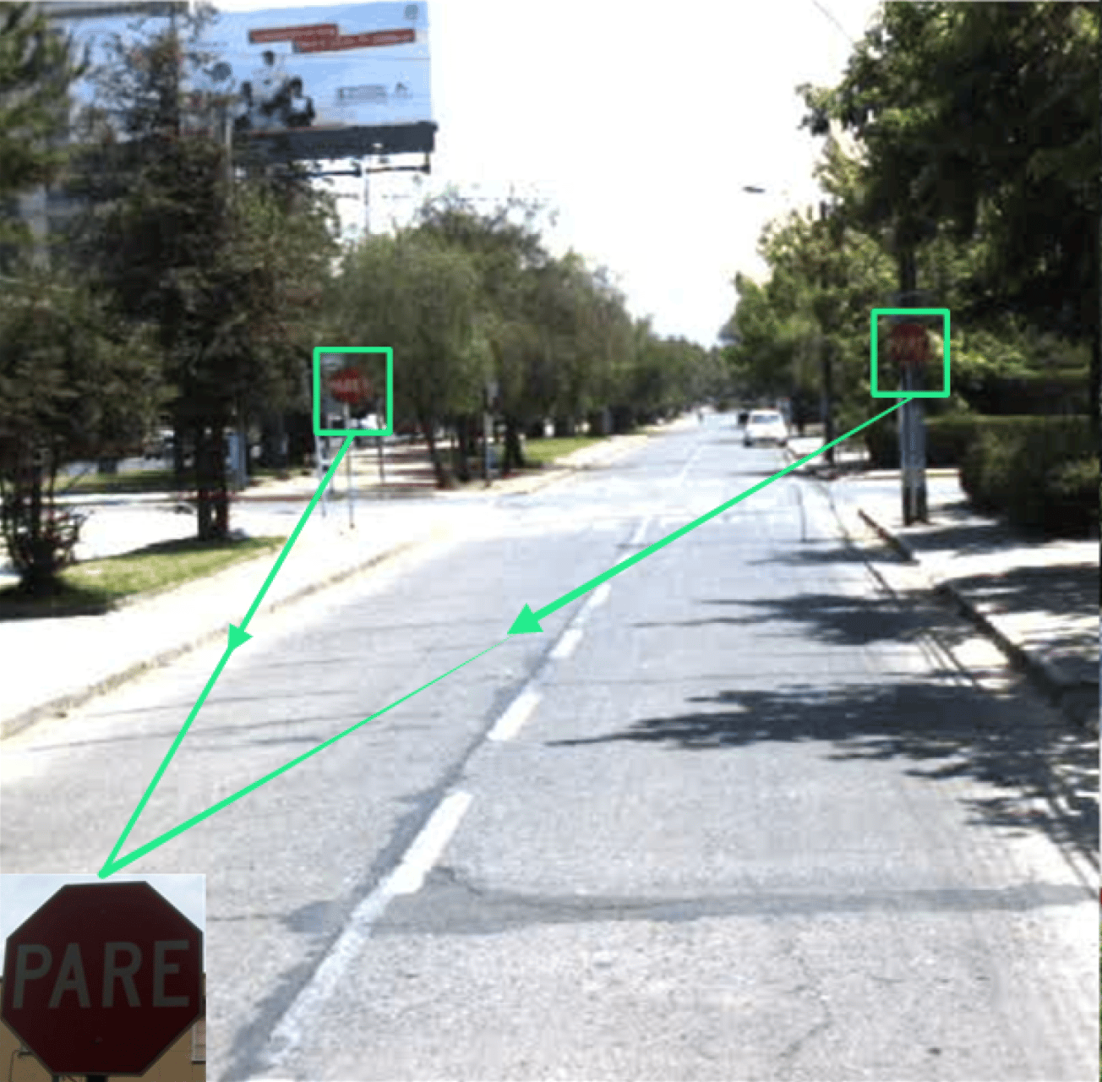
PROCEDURE:
Define Problem Statement
Collecting Dataset
Importing Packages
Train The Model
Save The Model
Test The Model

Slide 3
IMPORTANCE OF TRAFFIC SIGN DETECTION:
A traffic detection project using AI aims to enhance road safety, optimize traffic flow, and facilitate navigation. By leveraging AI techniques such as computer vision and machine learning, the system detects various elements of traffic, including vehicles, pedestrians, and traffic signs, in real-time. This enables timely responses to potential hazards, assists in traffic management decisions, and supports the development of intelligent transportation systems.
PROBLEM STATEMENT:
The problem statement for a traffic detection project using AI revolves around the need to develop an accurate and efficient system for detecting and classifying various elements of traffic in real-time. This includes vehicles, pedestrians, cyclists, and traffic signs, among others. The objective is to enhance road safety, optimize traffic flow, and support the development of intelligent transportation systems.

Slide 4
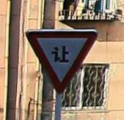
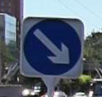
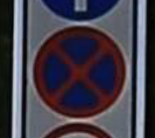

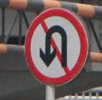

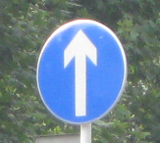





COLLECTING DATASET:
These are the few images from the dataset that have
been collected from the online source. I will give the
link of the dataset in the github repository .
Furthermore ,the dataset has labels.csv file which
contain labels of the images

Slide 5
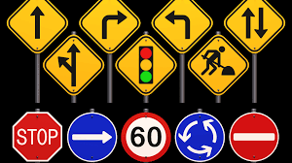
NECESSARY PACKAGES:
PANDAS
NUMPY
TENSORFLOW
KERAS
SCIKIT-LEARN
MATPLOTLIB
PYTHON IMAGING LIBRARY
RANDOM

Slide 6
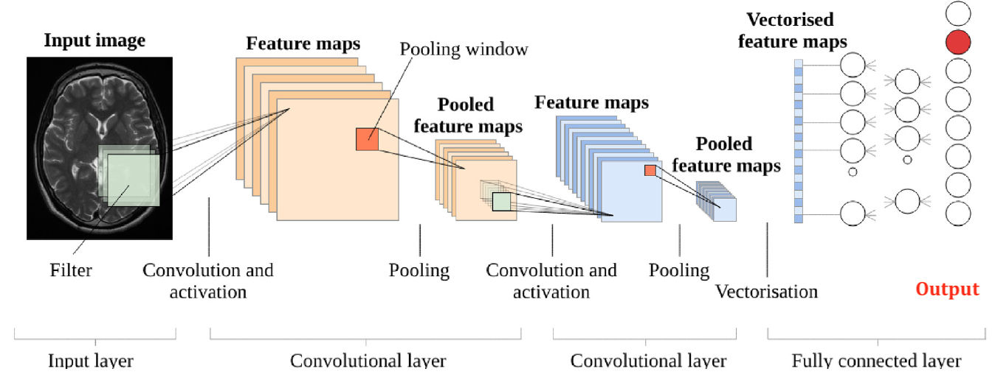
TRAINING USING CONVOLUTIONAL NEURAL NETWORK:

Slide 7
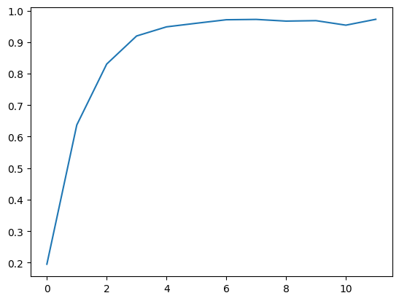
TESTING PHASE:
Testing accuracy gradually increases over epochs increases.
During the testing phase for traffic sign prediction, I carefully evaluate the AI system's ability to accurately recognize and interpret various traffic signs in different condition. I check how often it correctly identifies signs and whether it makes any mistakes. This helps us ensure that the model is reliable and can help automate
vehicles navigate safely and efficiently.

Slide 8
THANKYOU

